Slide 1
course registration database.
Shansi Dong
A20466369

Slide 2
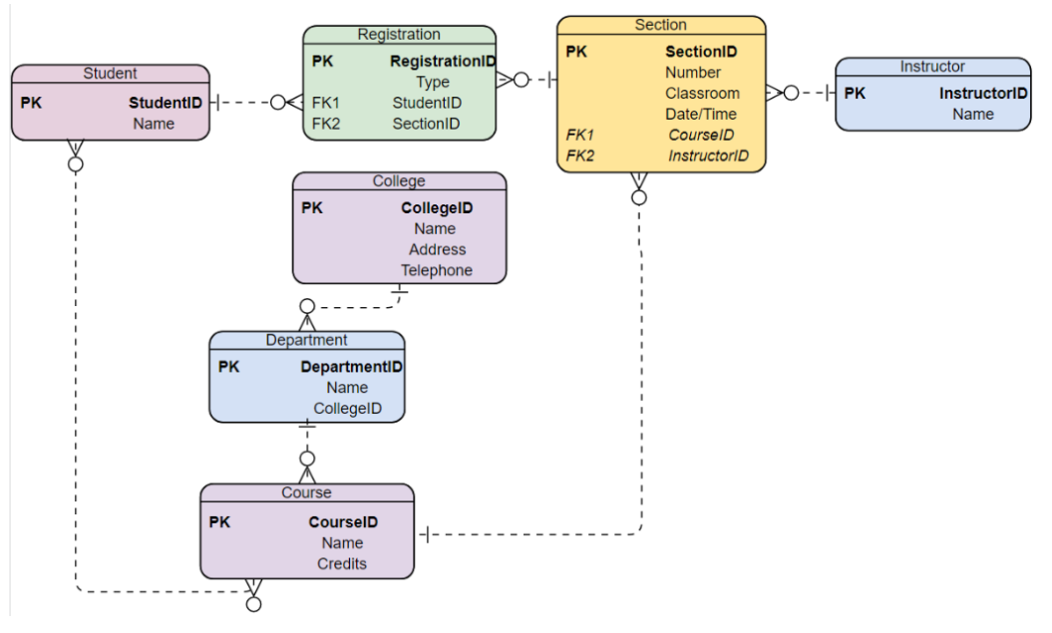

Slide 3
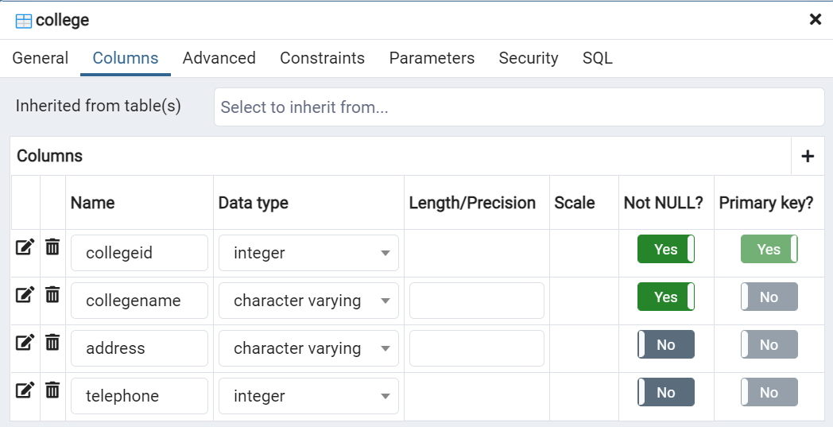
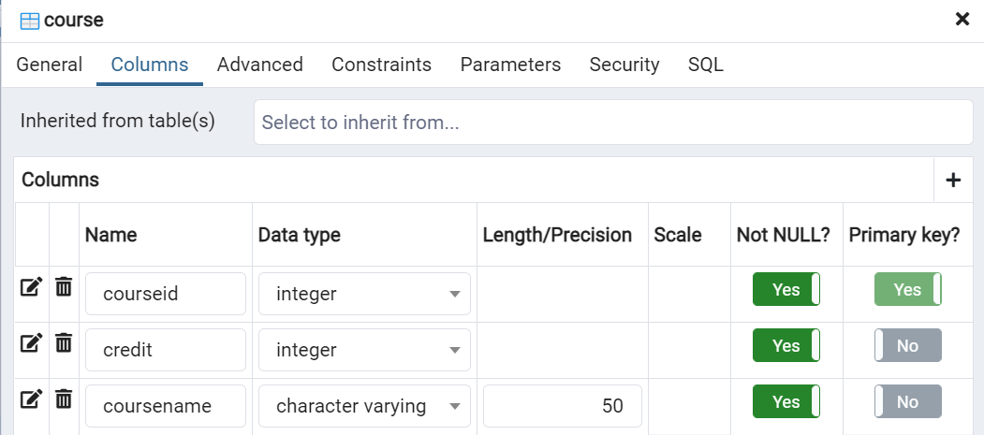

Slide 4
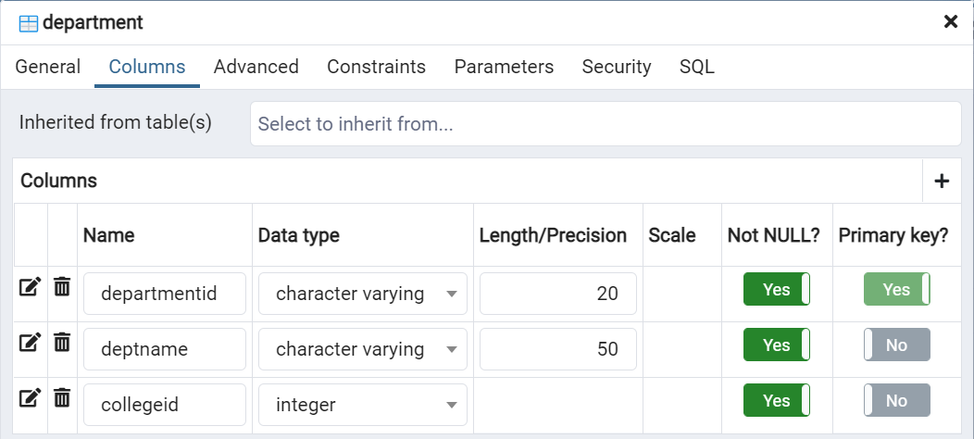
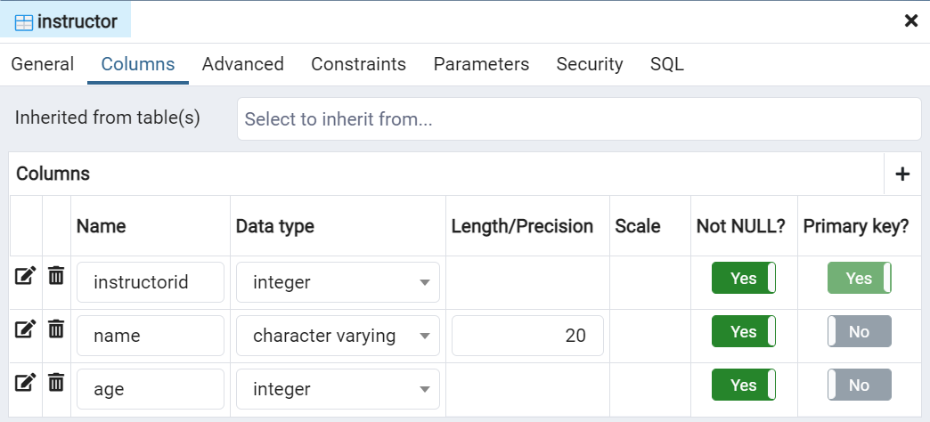

Slide 5
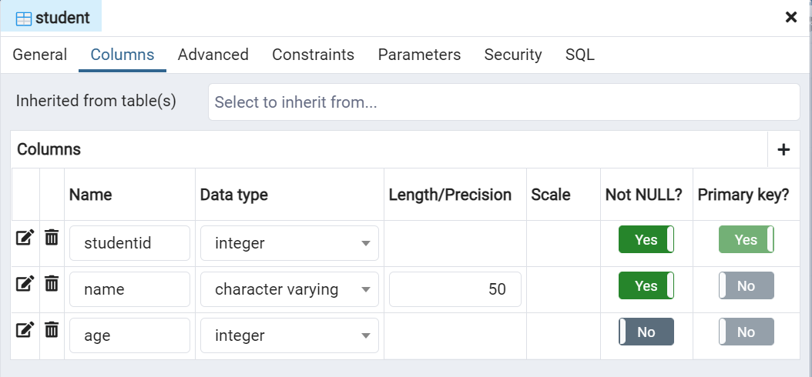


Slide 6
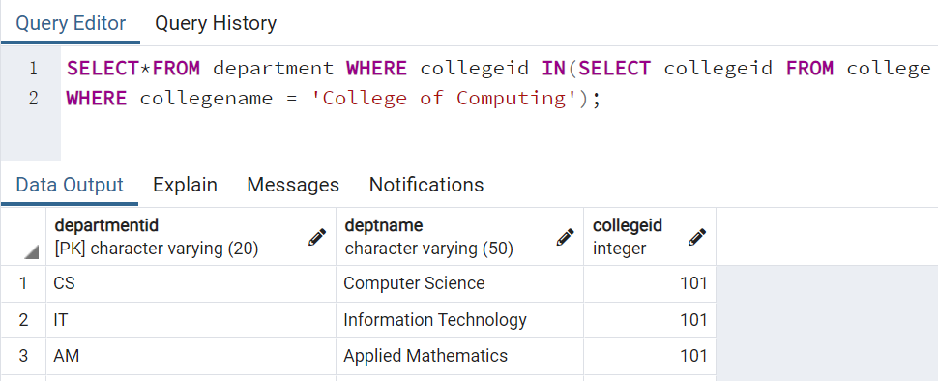
1. Create at least 10 different subqueries (with problem statement what to query) to search data using a table
1).What are all the departments from College of Computing?

Slide 7
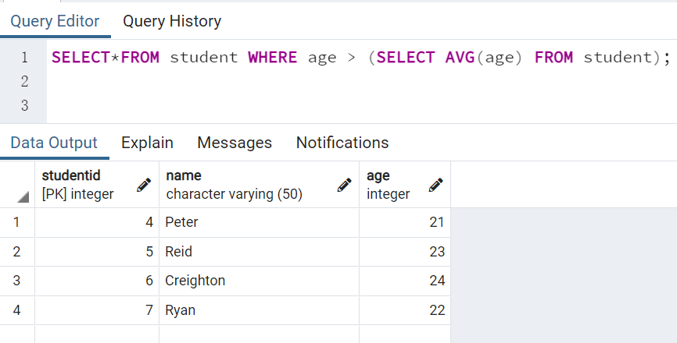
2). Using a subquery, list all the students with ages above the average.

Slide 8
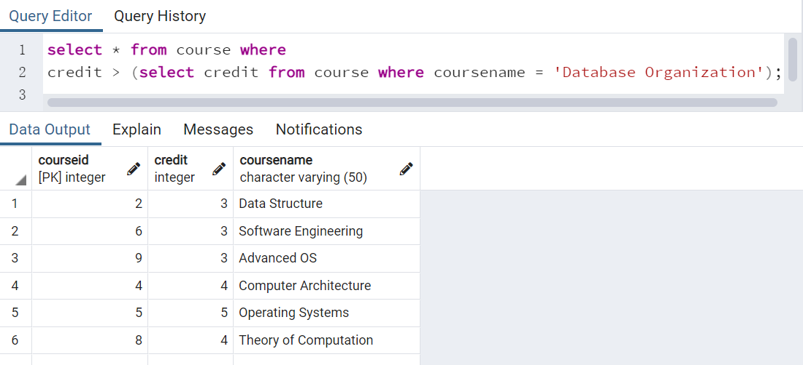
3). Using a subquery, list courses with credits larger than Database Organization.

Slide 9
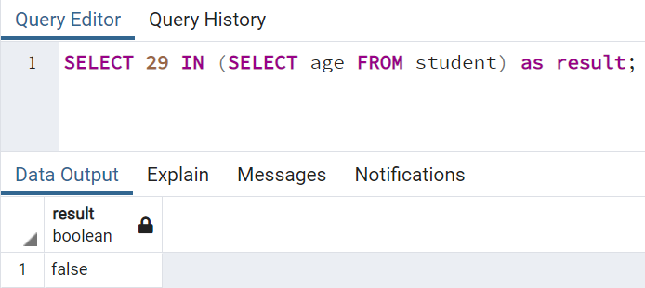
4). Using a subquery, to see if a student ages 29 exists within the student table:

Slide 10
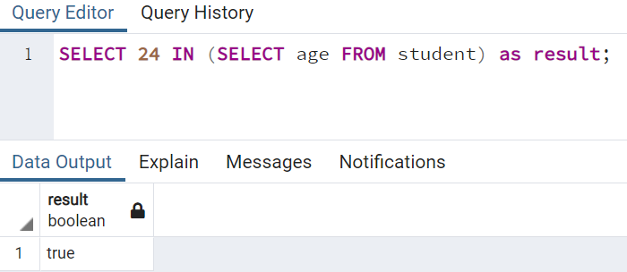
5). Using a subquery, to see if a student ages 24 exists within the student table:

Slide 11
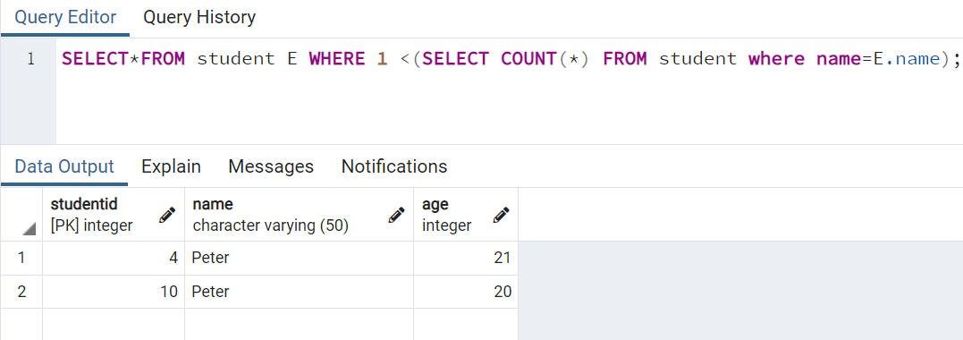
6). Using a subquery, to check if 2 or more students have the same name.

Slide 12
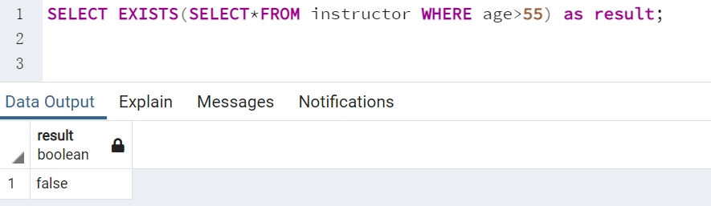
7). Using a subquery, to see if there’re any instructors with ages above 55 exist.

Slide 13
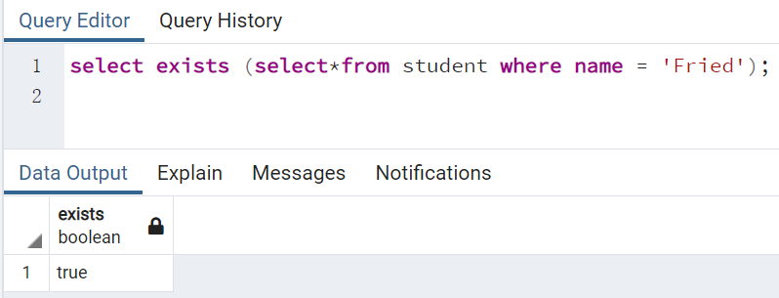
8). Using a subquery, to see if there’re any instructors with name Fried exist.

Slide 14
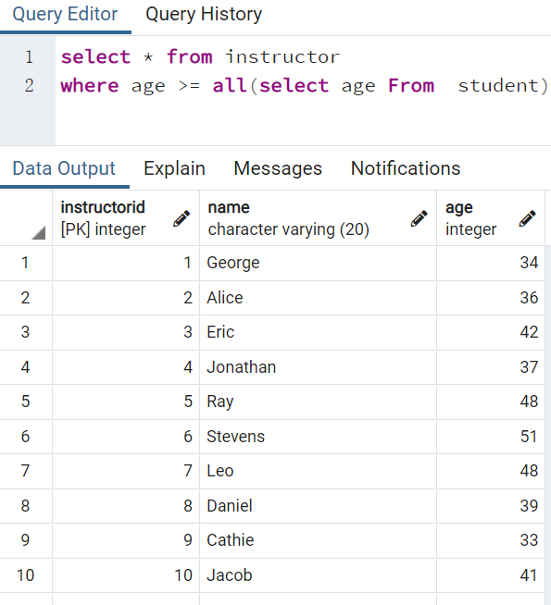
9). Using a subquery, list all the instructors whose ages above all students’ ages.

Slide 15
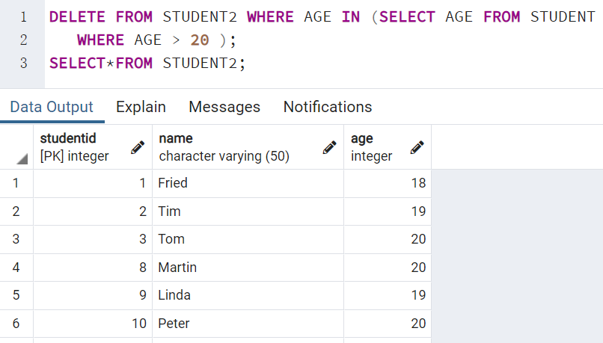
10). Using a subquery, delete all the students with ages above 20 from student2(which is a copy of table student)

Slide 16
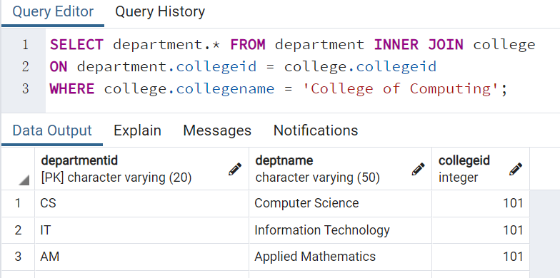
2. If you can get the same result without using subqueries as item1, use the alternative queries and results.
1).What are all the departments from College of Computing?

Slide 17
2. If you can get the same result without using subqueries as item1, use the alternative queries and results.
1).What are all the departments from College of Computing?

